Slide 2
Configuration Page
Company Name in Tally
Tally URL
Period : Current Year
Integrate Masters
Integrate Transactions
Ledger Groups and Ledgers
Sales and Sales Returns
Stock Groups and Stock Items
Purchase and Purchase Returns
Locations / Godown
Receipt and Payments
Cost Centers
Journals
Cost Categories
Sales Orders
Purchase Orders
Two Step Import / Export
Save
Cancel

Slide 3
Mapping Page
Master Type | Name in Frono | Name in Tally | Status
Ledgers |  |  | Active
Groups |  |  | Inactive
Locations
Cost Centers
Etc..
Save
Cancel

Slide 4


Main Page
Configuration
Mapping
Tally URL :
http://localhost:9000
Company Name in Tally :
Abcd Company
Only Masters
Start Import
Start Export

Slide 5
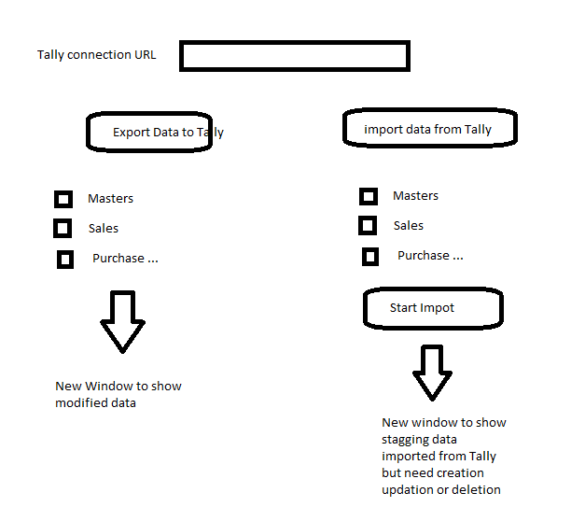

Slide 6
Export data to Tally Components
Show two Tabs : Masters tab selected
Masters
Vouchers
Master Type | Master Name | Change Type | Select | Status | Error
Ledgers |  | Create
Groups |  | Update
Locations |  | Delete
Cost Centers
Etc..
Start Export
This page will be read only when Two Step Import/Export is deactivated. It will just show the status.
The Export will be done only for selected data items. By default all the data will be selected.
The Status and Error Columns will be updated after Clicking the Start Export Button

Slide 7
Export data to Tally Components
Show two Tabs : Vouchers tab selected
Masters
Vouchers
Voucher Type | Master Name | Change Type | Select | Status | Error
Sale |  | Create
Purchase |  | Update
Receipts |  | Delete
Payments
Etc..
Start Export
This page will be read only when Two Step Import/Export is deactivated. It will just show the status.
The Export will be done only for selected data items. By default all the data will be selected.
The Status and Error Columns will be updated after Clicking the Start Export Button

Slide 8
Import Data from Tally
Show two Tabs : Masters tab selected
Masters
Vouchers
Master Type | Master Name | Change Type | Select | Status | Error
Ledgers |  | Create
Groups |  | Update
Locations |  | Delete
Cost Centers
Etc..
Start Import
This page will be read only when Two Step Import/Export is deactivated. It will just show the status.
The Export will be done only for selected data items. By default all the data will be selected.
The Status and Error Columns will be updated after Clicking the Start Export Button

Slide 9
Import data from Tally
Show two Tabs : Vouchers tab selected
Masters
Vouchers
Voucher Type | Master Name | Change Type | Select | Status | Error
Sale |  | Create
Purchase |  | Update
Receipts |  | Delete
Payments
Etc..
Start Import
This page will be read only when Two Step Import/Export is deactivated. It will just show the status.
The Export will be done only for selected data items. By default all the data will be selected.
The Status and Error Columns will be updated after Clicking the Start Export Button

